Slide 1






Democratizing the Cryptocurrency Ecosystem by
Just-In-Time Transformation of Mining Programs
Wei Liu , Zhenhua Li, Feng Qian, Feiyu Jin, Hao Lin
Yannan Zheng, Bo Xiao, Xiaokang Qin, Tianyin Xu
Notes:
OK, thanks for the introduction. Good afternoon, everyone. Today, I’m going to present our work on efficient just-in-time program transformations for democratizing the cryptocurrency ecosystems. This is joint work with colleagues from Tsinghua University, University of Southern California, Ant Group, and UIUC.

Slide 2
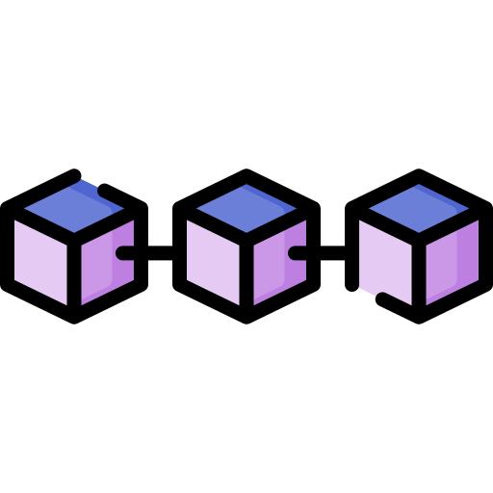

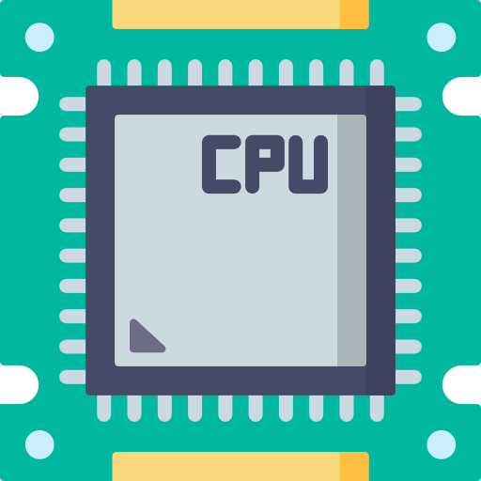



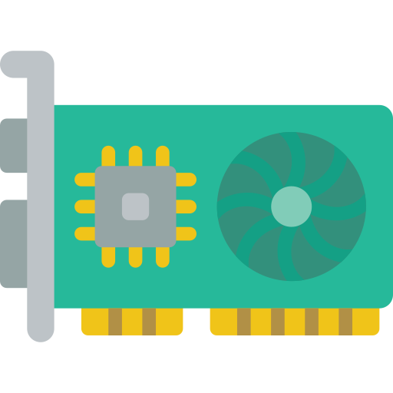

1. Background
Cryptomining is an important pillar for cryptocurrencies
  Miners solve computationally difficult puzzles for new transactions
  These puzzles make transactions to be securely added to blockchains
  The first miner to solve the puzzle is paid in cryptocurrency
New transaction
Miners
Encryption
Blockchain
Mining rewards
Notes:
Cryptomining is an essential pillar for today’s cryptocurrencies like Bitcoin, Ethereum, and Monero.
Subscribing miners solve computationally difficult mathematic puzzles for

Slide 3

1. Background
Democracy is crucial to cryptocurrency
  Cryptomining is decentralized to keep the credibility of cryptocurrency
  Supporting a variety of miners: mining farms, PC, web clients, etc.
  No individual entity can dominate the computation power
Web clients
PC clients
Democratic
Ecosystem
Mining farms
GPU platforms
Notes:
Large model training is emerging as an important business for cloud service providers (or CSPs for short).
This is because the training process of today’s large models always requires massive computing and networking resources, and thus significant cloud infrastructure supports.
For example, training large models like GPT-3 or Llama-3 involves hundreds to thousands of GPUs, lasting for weeks to months.
Large model training has become a cornerstone of modern AI services. Training models like GPT-3 or Llama-3 requires massive computational resources—often hundreds of thousands of GPUs running continuously for weeks or even months. This scale demands high-speed, low-latency networks, typically built on RDMA over Converged Ethernet (RoCE), where round-trip times must be under 20 microseconds to avoid slowing down training. At Alibaba Cloud, we support such workloads with over 40,000 RNICs and GPUs, serving millions of training tasks.

Slide 4
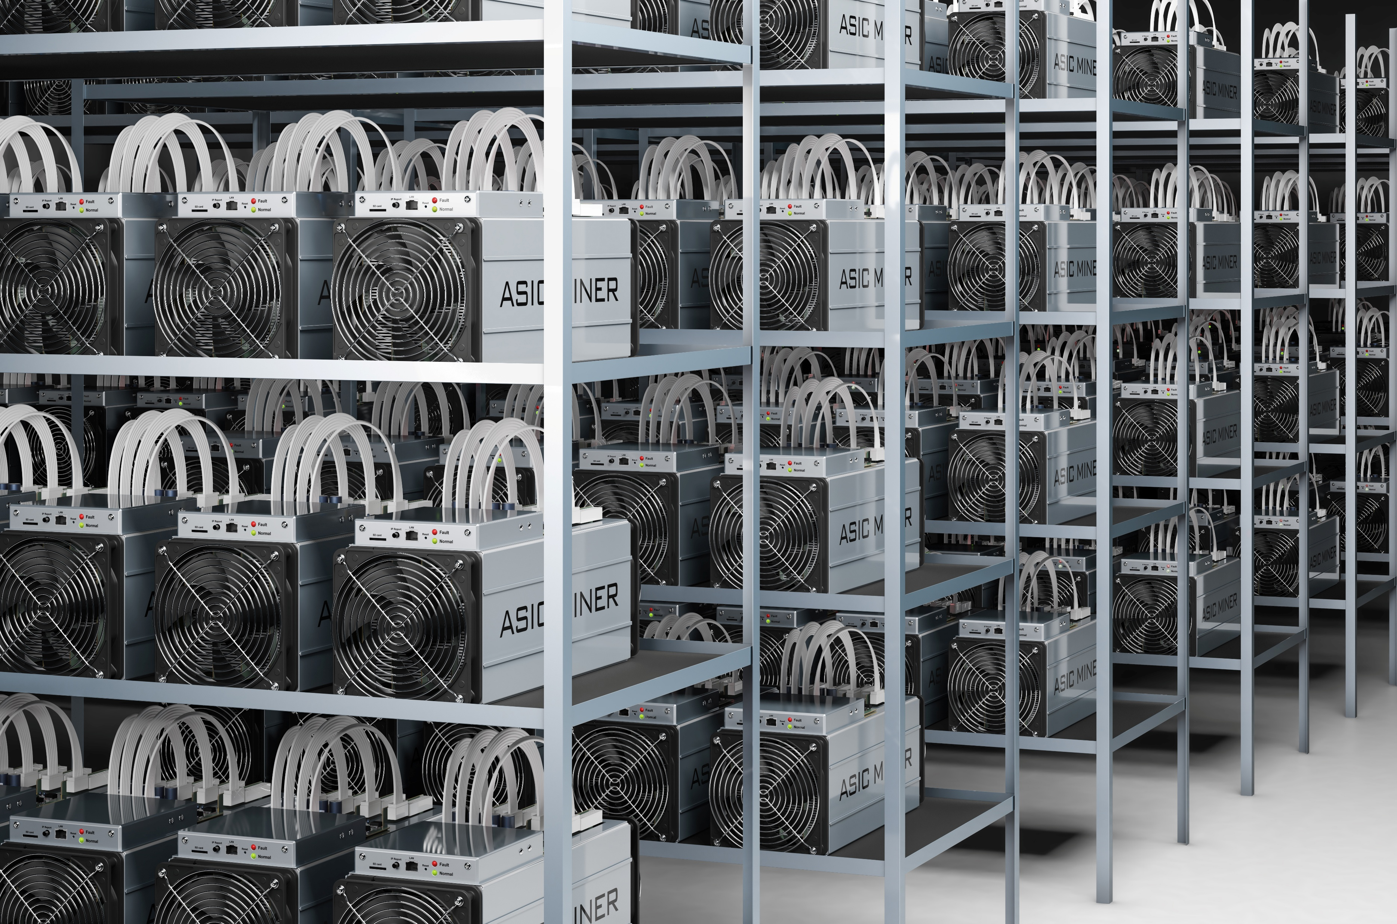

2. Motivation
Democracy is threatened by dedicated mining hardware
  ASICs and FPGAs
  Web-based mining dropped from 50M+ to <0.1M
  PC-based mining scaled down to ~0.8M
  Renders common users’ cryptomining less profitable or unprofitable
Mining farms
Web clients
PC clients
Common users
ASICs in mining farms
Notes:
To train a large model, users can launch a training task through either physical clusters or container clusters.
While a physical cluster is highly customizable for users, it requires the users to have professional experiences on configuring and coordinating the machines, GPUs, and RNICs.
Also, it is not flexible enough on scaling, and always incurs high operational cost.
In contrast, containerized large model training has now become popular given its lightweight and high flexibility.
Users can launch training tasks with different numbers of GPUs and RNICs on demand.
In this way, it is more cost-efficient and widely used by common users.
Users can launch training jobs on either physical clusters or containerized environments. Physical clusters offer high customizability but require deep expertise and lack elasticity. Containerized training, on the other hand, provides flexibility, ease of use, and cost efficiency. As a result, it has become the preferred choice for many users. Our cloud platform hosts a multi-tenant training environment that has served over 5 million containerized training tasks in the past three years.

Slide 5


2. Motivation
Breaking the monopoly
  Cryptocurrencies adopted new mining algorithms
    Monero: RandomX
    Scala: Panthera
  Rely on the architectural of general-purpose hardware
    Dynamic instruction execution
    Instruction vectorizations
  Reducing the efficiency of dedicated mining hardware
PC clients
Mining farms
Notes:
To train a large model, users can launch a training task through either physical clusters or container clusters.
While a physical cluster is highly customizable for users, it requires the users to have professional experiences on configuring and coordinating the machines, GPUs, and RNICs.
Also, it is not flexible enough on scaling, and always incurs high operational cost.
In contrast, containerized large model training has now become popular given its lightweight and high flexibility.
Users can launch training tasks with different numbers of GPUs and RNICs on demand.
In this way, it is more cost-efficient and widely used by common users.
Users can launch training jobs on either physical clusters or containerized environments. Physical clusters offer high customizability but require deep expertise and lack elasticity. Containerized training, on the other hand, provides flexibility, ease of use, and cost efficiency. As a result, it has become the preferred choice for many users. Our cloud platform hosts a multi-tenant training environment that has served over 5 million containerized training tasks in the past three years.

Slide 6
2. Motivation
However…
  New mining algorithms further impair web cryptomining 🙁
  Web is designed to hide hardware details for platform independence
  Have to emulate hardware features of general-purpose CPUs
    Directed rounding of floating points
    Diverse SIMD data types
Web Platforms
Browsers
X86 CPU
ARM CPU
RISC-V CPU
GPU
Notes:
As a major CSP, we have been operating a large-scale multi-tenant large model training cloud for over three years.
It is equipped with forty thousand RNICs and forty thousand GPUs, and has served over 5 million large model training tasks from users.
As you can see, the architecture of our containerized model training infrastructure is based on overlay networks, where containers can be created and allocated with RNICs and GPUs elastically.
Our underlay network is based on Alibaba HPN, which is specially optimized for AI workloads.
The reliability of containerized training is crucial. Training is highly synchronized—each step must complete within a tight latency bound. Even a small delay can slow down the entire process, and a failure can cause financial loss. However, pinpointing network issues is challenging due to container dynamics, endpoint complexity, and overlay-underlay interplay.

Slide 7
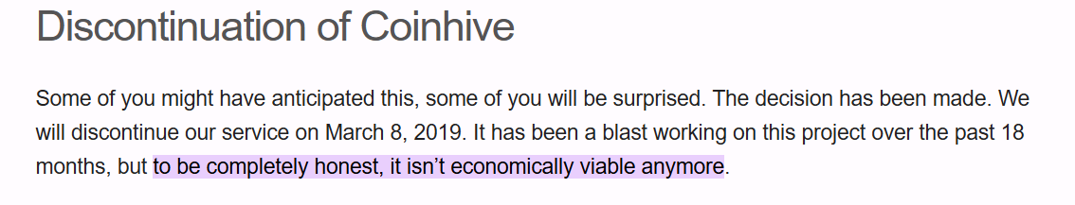
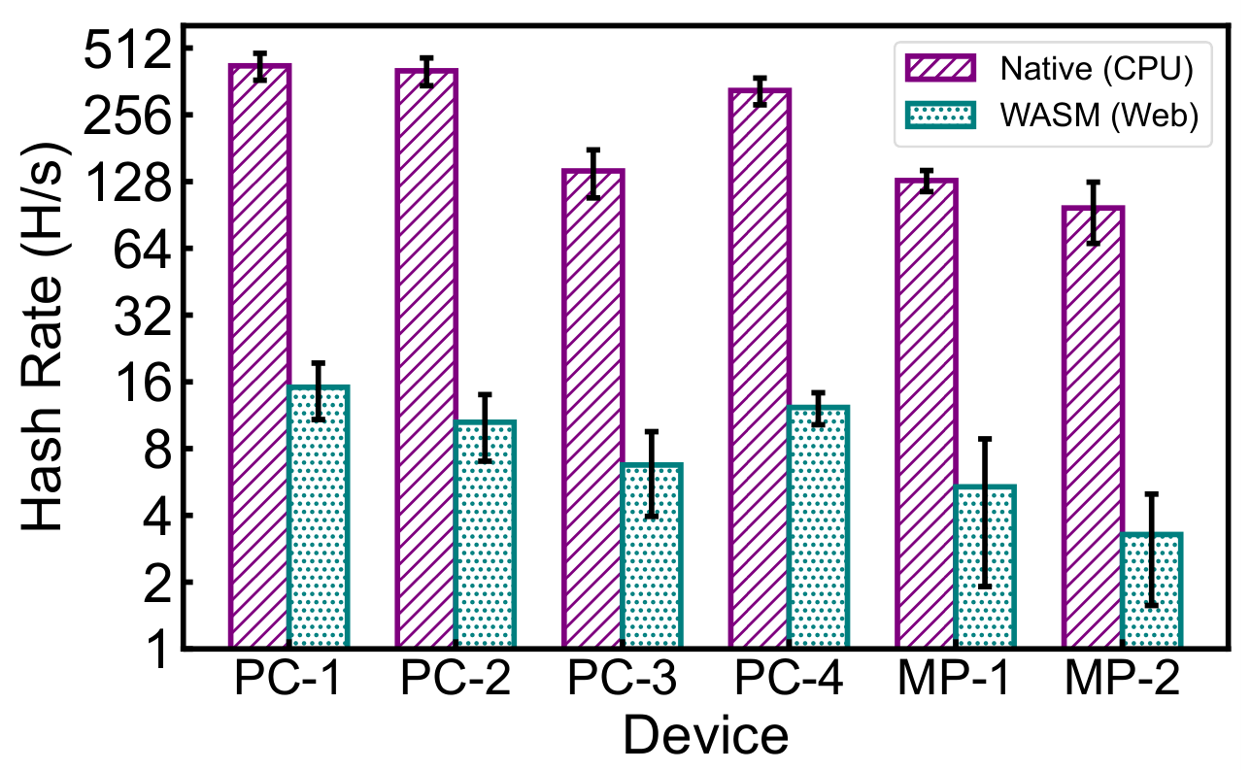
2. Motivation
So, the democracy has not been fully recovered
  Web cryptomining is severely slowed down
  Coinhive asserted
To be completed honest, it isn’t economically viable anymore.
Web clients
Notes:
As a major CSP, we have been operating a large-scale multi-tenant large model training cloud for over three years.
It is equipped with forty thousand RNICs and forty thousand GPUs, and has served over 5 million large model training tasks from users.
As you can see, the architecture of our containerized model training infrastructure is based on overlay networks, where containers can be created and allocated with RNICs and GPUs elastically.
Our underlay network is based on Alibaba HPN, which is specially optimized for AI workloads.
The reliability of containerized training is crucial. Training is highly synchronized—each step must complete within a tight latency bound. Even a small delay can slow down the entire process, and a failure can cause financial loss. However, pinpointing network issues is challenging due to container dynamics, endpoint complexity, and overlay-underlay interplay.

Slide 8
3. Analysis
Inefficiency of web cryptomining—a RandomX example
  New Monero Transaction→Dynamic Mining Program (RandomX ISA)
  Dynamic Mining Program (RandomX ISA) →WASM Emulations
FMUL_R x, y
FMUL_R z, y
XOR_R x, z
# 8 instructions for exponent ADD:
local.get $x0 | local.get $y0 | i32.add | local.set $x0
local.get $x1 | local.get $y1 | i32.add | local.set $x1
··· # 16 more instructions for mantissa MUL and sign bit XOR
local.get $z0 | local.get $y0 | i32.add | local.set $z0
local.get $z1 | local.get $y1 | i32.add | local.set $z1
··· # 16 more instructions for mantissa MUL and sign bit XOR
local.get $x0 | local.get $z0 | i32.xor | local.set $x0
local.get $x1 | local.get $z1 | i32.xor | local.set $x1
··· # 16 more instructions for mantissa XOR and sign bit XOR | local.set $z1m | i64.xor | local.set $x1m
x=x*y
z=z*y
Mining
Instructions
x=x⊕z
Emulated WASM Instructions
Notes:
Under such a large scale, reliable networking is crucial for service quality, particularly the connectivity among the training nodes.
This is because the training nodes’ GPUs should be connected under a low-latency, high-bandwidth networks, either intra-host or inter-host networks, for high-performance training data exchanging.
Also, large model training is highly synchronized. Each training step requires all workers to exchange gradients simultaneously. Even a minor network issue—like a 1-milisecond latency increase—can slow down training by 20%.
A failure lasting more than 4 seconds can cause the entire job to fail, and finally cause substantial financial loss to customers.

Slide 9
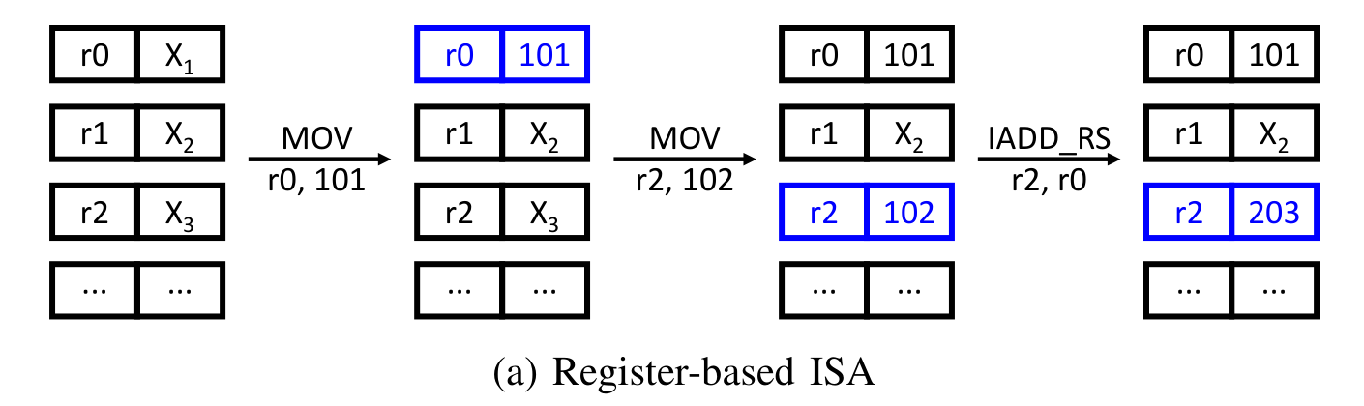
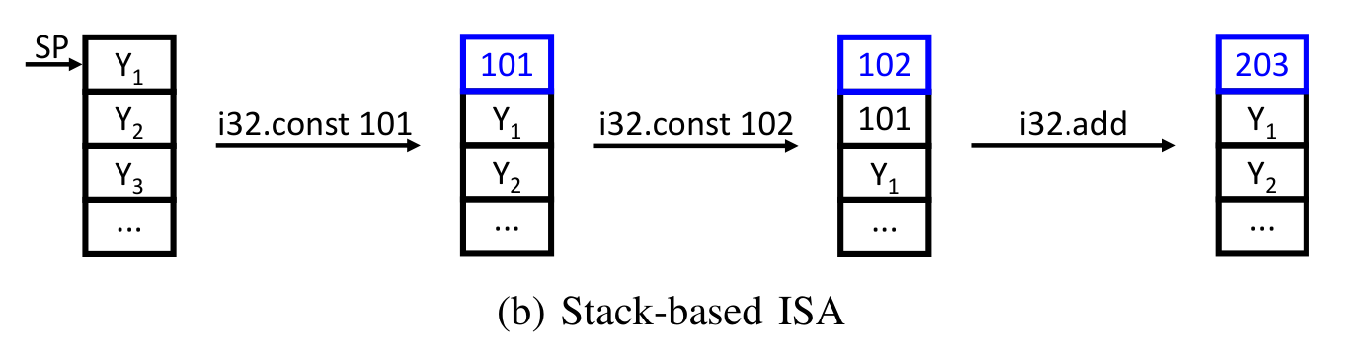
3. Analysis
Why dynamic mining programs are emulated in WASM
  Common CPU ISAs: register-based
  WASM ISA: stack-based for better portability across the web
    No special registers for state maintenance
    Limited data types
ISA Incompatibilities
Notes:
Under such a large scale, reliable networking is crucial for service quality, particularly the connectivity among the training nodes.
This is because the training nodes’ GPUs should be connected under a low-latency, high-bandwidth networks, either intra-host or inter-host networks, for high-performance training data exchanging.
Also, large model training is highly synchronized. Each training step requires all workers to exchange gradients simultaneously. Even a minor network issue—like a 1-milisecond latency increase—can slow down training by 20%.
A failure lasting more than 4 seconds can cause the entire job to fail, and finally cause substantial financial loss to customers.

Slide 10
















3. Design of Vectra
Just-in-time transformation of mining programs
  Element propagation graph (EPG) modeling
# 8 instructions for exponent ADD:
local.get $x0 | local.get $y0 | i32.add | local.set $x0
local.get $x1 | local.get $y1 | i32.add | local.set $x1
··· # 16 more instructions for mantissa MUL and sign bit XOR
local.get $z0 | local.get $y0 | i32.add | local.set $z0
local.get $z1 | local.get $y1 | i32.add | local.set $z1
··· # 16 more instructions for mantissa MUL and sign bit XOR
local.get $x0 | local.get $z0 | i32.xor | local.set $x0
local.get $x1 | local.get $z1 | i32.xor | local.set $x1
··· # 16 more instructions for mantissa XOR and sign bit XOR | local.set $z1m | i64.xor | local.set $x1m
$$x$$
$$y$$
$$z$$
$$x_{0}$$
$$x_{1}$$
$$y_{0}$$
$$y_{1}$$
$$z_{0}$$
$$z_{1}$$
$$+$$
$$+$$
$$+$$
$$+$$
$$x_{0}^{′}$$
$$x_{1}^{′}$$
$$z_{0}^{′}$$
$$z_{1}^{′}$$
⊕
⊕
$$x_{0}^{′′}$$
$$x_{1}^{′′}$$
Element propagation graph
Emulated WASM instructions
Notes:
Under such a large scale, reliable networking is crucial for service quality, particularly the connectivity among the training nodes.
This is because the training nodes’ GPUs should be connected under a low-latency, high-bandwidth networks, either intra-host or inter-host networks, for high-performance training data exchanging.
Also, large model training is highly synchronized. Each training step requires all workers to exchange gradients simultaneously. Even a minor network issue—like a 1-milisecond latency increase—can slow down training by 20%.
A failure lasting more than 4 seconds can cause the entire job to fail, and finally cause substantial financial loss to customers.

Slide 11
















3. Design of Vectra
Just-in-time transformation of mining programs
  Merge instructions in isomorphic element prapagations
  ISA-compatible efficient SIMD instructions
$$x$$
$$y$$
$$z$$
v128.load $V0(x0,x1,y0,y1) v128.load $V1(y0,y1,z0,z1) i32x4.add # SIMD ADD
# x0',x1',z0',z1' on stack
v128.load32x2 $V2(x0',x1') v128.load32x2 $V3(z0',z1') i64x2.xor # SIMD XOR
# x0",x1" on stack
$$x_{0}$$
$$x_{1}$$
$$y_{0}$$
$$y_{1}$$
$$z_{0}$$
$$z_{1}$$
$$+$$
$$+$$
$$+$$
$$+$$
$$x_{0}^{′}$$
$$x_{1}^{′}$$
$$z_{0}^{′}$$
$$z_{1}^{′}$$
⊕
⊕
$$x_{0}^{′′}$$
$$x_{1}^{′′}$$
Element propagation graph
Merged WASM SIMD instructions
Notes:
Under such a large scale, reliable networking is crucial for service quality, particularly the connectivity among the training nodes.
This is because the training nodes’ GPUs should be connected under a low-latency, high-bandwidth networks, either intra-host or inter-host networks, for high-performance training data exchanging.
Also, large model training is highly synchronized. Each training step requires all workers to exchange gradients simultaneously. Even a minor network issue—like a 1-milisecond latency increase—can slow down training by 20%.
A failure lasting more than 4 seconds can cause the entire job to fail, and finally cause substantial financial loss to customers.

Slide 12
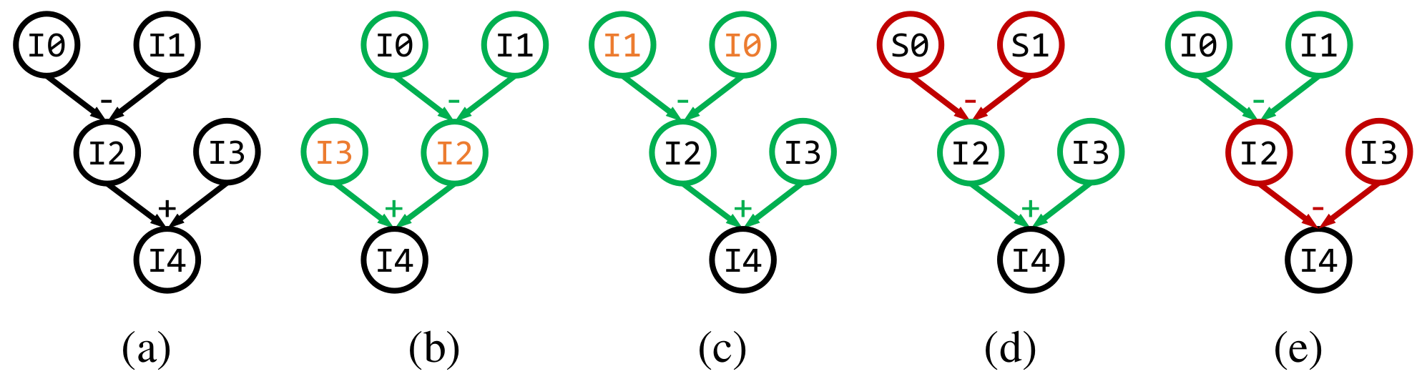
3. Design of Vectra
Finding optimal EGP components that are isomorphic
  Graph isomorphisms
  High time complexity of O(n!)
Notes:
Under such a large scale, reliable networking is crucial for service quality, particularly the connectivity among the training nodes.
This is because the training nodes’ GPUs should be connected under a low-latency, high-bandwidth networks, either intra-host or inter-host networks, for high-performance training data exchanging.
Also, large model training is highly synchronized. Each training step requires all workers to exchange gradients simultaneously. Even a minor network issue—like a 1-milisecond latency increase—can slow down training by 20%.
A failure lasting more than 4 seconds can cause the entire job to fail, and finally cause substantial financial loss to customers.

Slide 13


3. Design of Vectra
Finding optimal EGP components that are isomorphic
  Key idea: use locality of data dependencies to bound searching process
  Locality metric:
  Group graph nodes based on L(x, y)
  Search happens only in each group
↓99% search time reduction
Notes:
Under such a large scale, reliable networking is crucial for service quality, particularly the connectivity among the training nodes.
This is because the training nodes’ GPUs should be connected under a low-latency, high-bandwidth networks, either intra-host or inter-host networks, for high-performance training data exchanging.
Also, large model training is highly synchronized. Each training step requires all workers to exchange gradients simultaneously. Even a minor network issue—like a 1-milisecond latency increase—can slow down training by 20%.
A failure lasting more than 4 seconds can cause the entire job to fail, and finally cause substantial financial loss to customers.

Slide 14
3. Design of Vectra
Ensuring correct program transformation
  Instruction merging is risky
①
ISUB_R, R0, R1
ISUB_R, R2, R3
...
ISUB_R, R4, R5
CBRANCH, R2
ISUB_R, R6, R7
R₀
R₁
R₂
R₃
-
-
v2-v0
i64x2.sub v2, v0
...
br_if r2_label
...
i64x2.sub v4, v6
②
×
×
R₀
R₂
③
R₄
R₅
R₆
R₇
-
-
v6-v4
④
R₄
R₆
×
RandomX Instructions
Element Propagations
Merged WASM Instructions
Notes:
Under such a large scale, reliable networking is crucial for service quality, particularly the connectivity among the training nodes.
This is because the training nodes’ GPUs should be connected under a low-latency, high-bandwidth networks, either intra-host or inter-host networks, for high-performance training data exchanging.
Also, large model training is highly synchronized. Each training step requires all workers to exchange gradients simultaneously. Even a minor network issue—like a 1-milisecond latency increase—can slow down training by 20%.
A failure lasting more than 4 seconds can cause the entire job to fail, and finally cause substantial financial loss to customers.

Slide 15
3. Design of Vectra
Ensuring correct program transformation
  Symbolic constrains on branching instructions
  Jump table recovery
ISUB_R, R0, R1
ISUB_R, R2, R3
...
ISUB_R, R4, R5
CBRANCH, R2
ISUB_R, R6, R7
R₀
R₁
R₂
R₃
-
-
v2-v0
i64x2.sub v2, v0
...
br_if r2_label
...
i64x2.sub v4, v6
Recover vector v2
×
×
i64.sub r2, r3
i64x2.rep_lane 1
...
i64.sub r4, r5
br r2_next
R₀
R₂
R₄
R₅
R₆
R₇
-
-
v6-v4
R₄
R₆
×
RandomX Instructions
Element Propagations
Merged WASM Instructions
Per-branch Jump Table
Notes:
Under such a large scale, reliable networking is crucial for service quality, particularly the connectivity among the training nodes.
This is because the training nodes’ GPUs should be connected under a low-latency, high-bandwidth networks, either intra-host or inter-host networks, for high-performance training data exchanging.
Also, large model training is highly synchronized. Each training step requires all workers to exchange gradients simultaneously. Even a minor network issue—like a 1-milisecond latency increase—can slow down training by 20%.
A failure lasting more than 4 seconds can cause the entire job to fail, and finally cause substantial financial loss to customers.

Slide 16
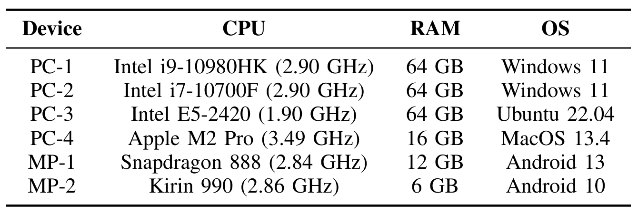
4. Evaluation
Evaluation setups
  Devices used for testing
  Compared solutions
    RandomX Compiler-Optimized
    RandomX WASM
    RandomX-JS
Notes:
Under such a large scale, reliable networking is crucial for service quality, particularly the connectivity among the training nodes.
This is because the training nodes’ GPUs should be connected under a low-latency, high-bandwidth networks, either intra-host or inter-host networks, for high-performance training data exchanging.
Also, large model training is highly synchronized. Each training step requires all workers to exchange gradients simultaneously. Even a minor network issue—like a 1-milisecond latency increase—can slow down training by 20%.
A failure lasting more than 4 seconds can cause the entire job to fail, and finally cause substantial financial loss to customers.

Slide 17
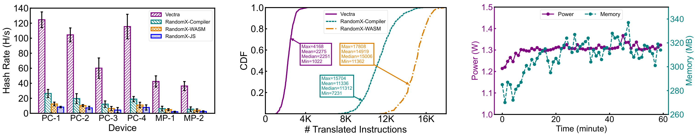
4. Evaluation
End-to-end performance
  3X-16X faster at mining Monero
  7X instruction reduction
  Negligible resource consumptions even on mobile devices
Notes:
Under such a large scale, reliable networking is crucial for service quality, particularly the connectivity among the training nodes.
This is because the training nodes’ GPUs should be connected under a low-latency, high-bandwidth networks, either intra-host or inter-host networks, for high-performance training data exchanging.
Also, large model training is highly synchronized. Each training step requires all workers to exchange gradients simultaneously. Even a minor network issue—like a 1-milisecond latency increase—can slow down training by 20%.
A failure lasting more than 4 seconds can cause the entire job to fail, and finally cause substantial financial loss to customers.

Slide 18
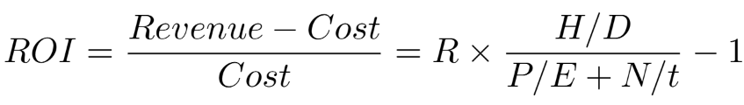
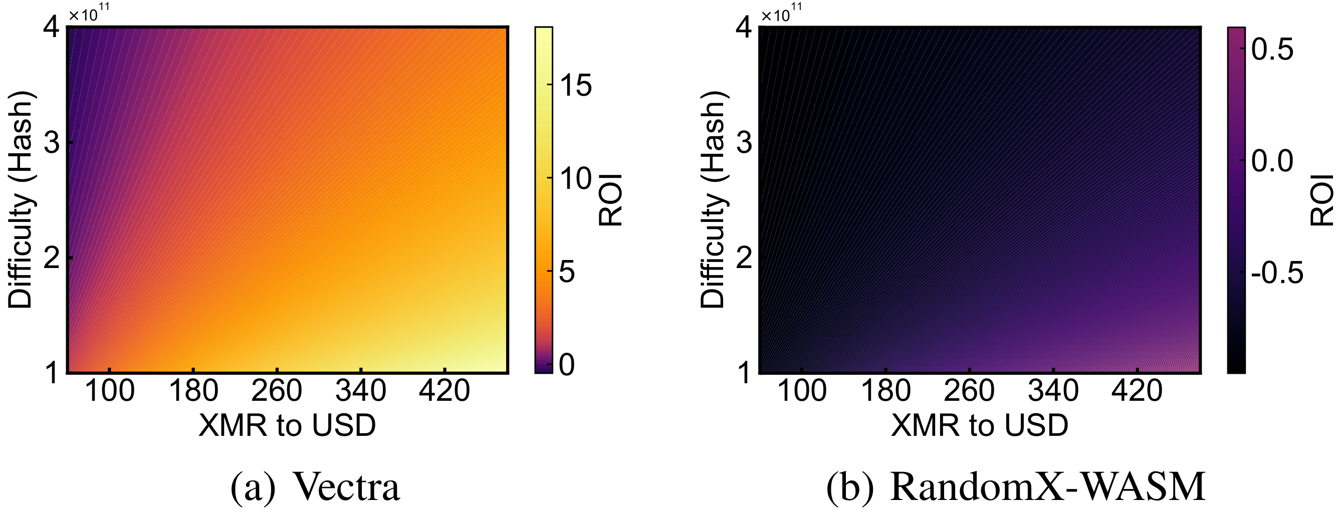
4. Evaluation
Real-world economic benefits
  Vetra provides a return-on-investment (ROI) of 69% — 274% to users
  H: hash rate, D: mining difficulty
  P: CPU power consumption
  E: Electricity price, R: exchange rate
Notes:
Under such a large scale, reliable networking is crucial for service quality, particularly the connectivity among the training nodes.
This is because the training nodes’ GPUs should be connected under a low-latency, high-bandwidth networks, either intra-host or inter-host networks, for high-performance training data exchanging.
Also, large model training is highly synchronized. Each training step requires all workers to exchange gradients simultaneously. Even a minor network issue—like a 1-milisecond latency increase—can slow down training by 20%.
A failure lasting more than 4 seconds can cause the entire job to fail, and finally cause substantial financial loss to customers.

Slide 19
5. Conclusion
We conduct an in-depth study on the democracy of the cryptocurrency ecosystem, and show how program analysis can benefit web cryptomining with new mining algorithms.
We reveal the root cause of inefficient web cryptomining — the gap between the ISAs of WASM (a high-level, portable language for web) and the native CPU.
We develop Vetra, a just-in-time program transformation technique to close the gap and enable profitable web cryptomining. It speeds up web cryptomining by 3X—16X and provides an ROI of 69% — 274% to users.
Thanks!
Q & A
Notes:
So let me conclude our work.
We are the first to point out the real-world challenges against reliable network support for large-scale containerized model training, as well as their multiplicative effect on troubleshooting the connectivity issues.
We propose SkeletonHunter, a container network monitoring and diagnosis system that leverages the unique traffic patterns of large model training to accurately and efficiently pinpoint the connectivity issues.
SkeletonHunter has been deployed in our production container network and has shown its efficacy in network failure detection and localization.
That’s all. Thanks for your attention, and I’m ready for Q and A.

